Slide 1
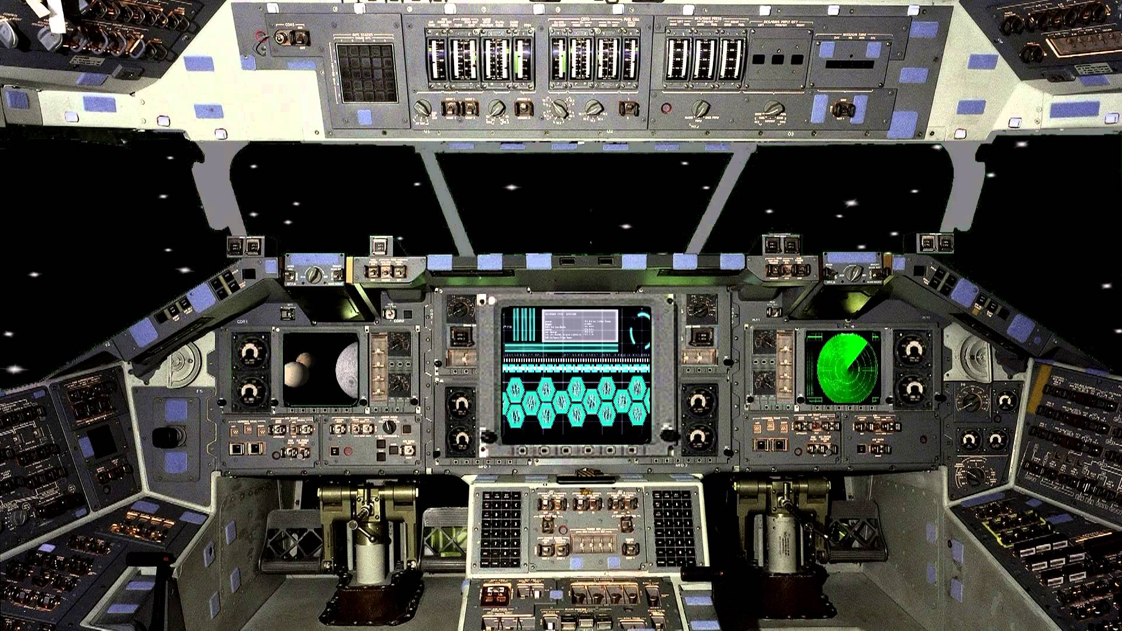
EXIT
START GAME
CREDITS
OPTIONS

Slide 2

RUN PROGRAM
START SCREEN
CREDITS
EXIT PROGRAM
ANY KEY
BUTTON
BUTTON
MAIN MENU
BUTTON
BUTTON
LEVEL SELECT
OPTIONS
BUTTON
BUTTON
“ESC” KEY
IN-GAME
PAUSE MENU
BUTTON
OPTIONS (PAUSED)
BUTTON

Slide 3


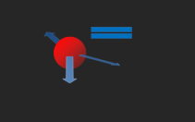




OBJECTIVE: APPROACH THE MARKED
SATELLITES FOR CLOSER EXAMINATION
?
lllllllllll
lllllllllllllllllllllllllllllllllllllllll
SAT A
SAT B

Slide 4
OBJECTIVE: APPROACH THE MARKED
SATELLITES FOR CLOSER EXAMINATION
?
lllllllllll
lllllllllllllllllllllllllllllllllllllllll
GAME PAUSED
RESUME GAME
RESTART LEVEL
EXIT LEVEL
OPTIONS
SAT A
SAT B

Slide 5
OBJECTIVE: APPROACH THE MARKED
SATELLITES FOR CLOSER EXAMINATION
?
lllllllllll
lllllllllllllllllllllllllllllllllllllllll
OPTIONS
MUSIC ON
SOUNDS OFF
SCREEN SIZE 2
BACK
SAT A
SAT B

Slide 6
LAUNCH
FUEL
LIFE SUPPORT
ENGINE
INITIAL THRUST WEIGHT
LAUNCH ANGLE
<IMAGE>
READY

Slide 7

